Slide 1
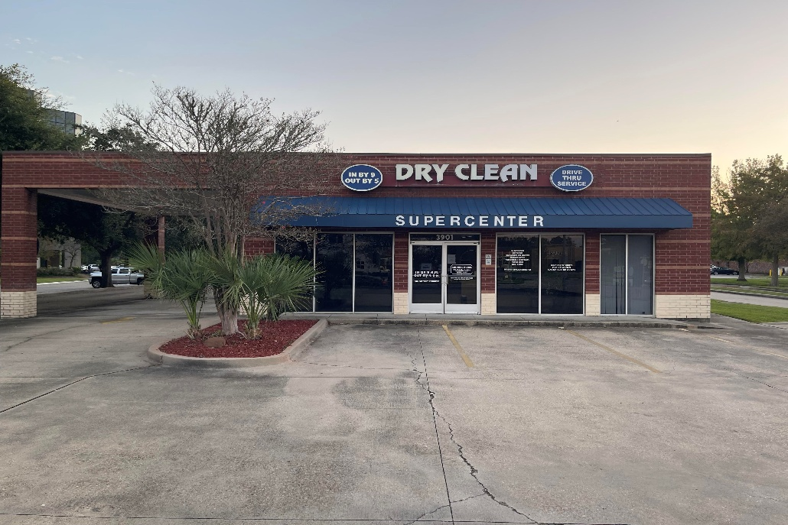
Securing Small Business Payment Systems
A Governance, Risk, and Compliance Roadmap:
Dry Clean Super Center

Slide 2
Introduction to Dry Clean Super Center
Small business offering cleaning services, with digital payment processing
Relies on WinCleaners Point-of-Sale (POS) and Global Payments Integrated (GPI) for transactions
Handles sensitive customer data which requires a robust cybersecurity posture

Slide 3
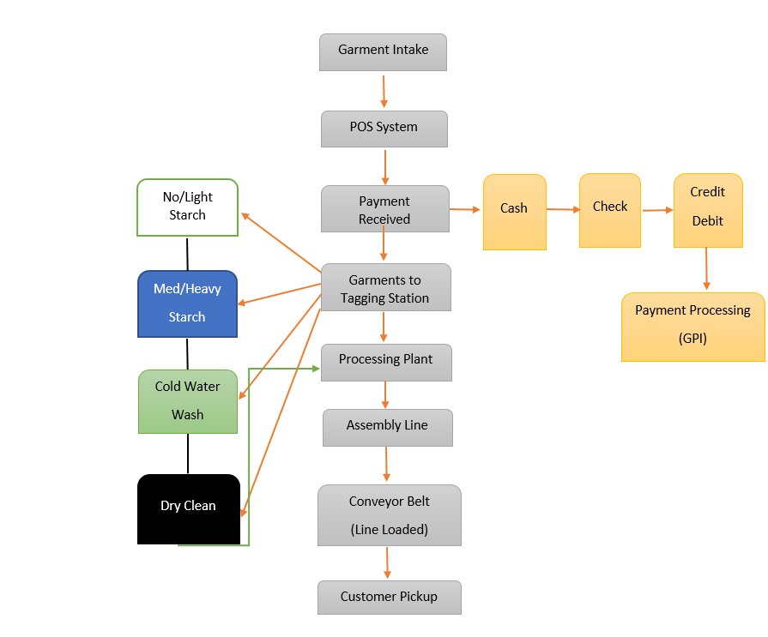
Garment Intake Process

Slide 4
Current Cybersecurity Posture
Mix of manual processes and vendor-provided protections
Use of WinCleaners POS with built-in security (encryption, tokenization)
GPI adds PCI-validated payment processing
Security measures in place, but limited maturity compared to enterprise standards

Slide 5
WinCleaners POS Security
Supports end-to-end encryption of cardholder data
Uses tokenization to replace sensitive card data
Logs and monitoring integrated
Data flow: Customer POS terminal Encrypted transmission GPI Bank

Slide 6
Global Payments Integrated (GPI)
PCI DSS Level 1 service provider
Fraud monitoring and real-time risk analysis
Tokenization and secure API integration
Ensures merchant transactions meet compliance and lower liability

Slide 7
Mapping the Division of Responsibility between GPI and the Merchant
Security Task | GPI | Merchant
Encrypting Card Data | Yes | No
Tokenization and Storage | Yes | No
PCI DSS Compliance of Platform | Yes | No
PCI Self Questionnaire Assessment (SQA) | No | Yes
Securing Merchant Network/ Devices | No | Yes
Fraud Monitoring Tools | Yes | No
Training Staff | No | Yes
Chargeback Response | No | Yes

Slide 8
Payment Card Industry Data Security Standard (PCI DSS) Overview
12 Core Requirements across 6 Objectives (PCI DSS)
Build and maintain secure networks
Protect card holder data
Maintain vulnerability management
Implement strong access controls
Monitor and test networks
Maintain information security policy

Slide 9
National Institute of Standards and Technology’s Cybersecurity Framework (NIST CSF)
Five core functions: Identify, Protect, Detect, Respond, Recover
Provides a roadmap to maturity
Aligns with PCI DSS but extends resilience and incident response

Slide 10
PCI DSS requirements against the NIST CSF functions
PCI DSS Objective / Requirements | Corresponding NIST CSF Function(s) | Small Business Implementation Notes
Build and Maintain a Secure Network and Systems | Identify, Protect | Configure firewalls, secure Wi-Fi, segment networks; small business can use managed firewall solutions
Install and maintain network security controls | Protect | Use hardware/software firewalls and intrusion prevention
2. Apply secure configurations to all system components | Protect | Change default passwords, disable unnecessary services, apply patches regularly
Protect Cardholder Data | Protect | Encrypt stored cardholder data and transmissions; train staff on safe data handling
3. Protect stored account data | Protect | Implement encryption and access controls
4. Encrypt transmission of cardholder data over open networks | Protect | Use TLS/SSL or secure VPNs for data transmission
Maintain a Vulnerability Management Program | Identify, Protect, Detect | Regularly scan for malware and vulnerabilities; small businesses can leverage free or low-cost scanning tools
5. Protect systems and networks from malicious software | Detect, Protect | Install antivirus/anti-malware, schedule regular scans
6. Develop and maintain secure systems and applications | Protect | Apply software updates and secure development practices
Implement Strong Access Control Measures | Protect, Detect | Limit access to cardholder data; assign unique IDs; enforce MFA
7. Restrict access by business need-to-know | Protect | Role-based access control
8. Identify and authenticate users | Protect | Strong passwords, multifactor authentication
9. Restrict physical access to cardholder data | Protect | Lock storage areas, restrict office access
Regularly Monitor and Test Networks | Detect, Respond | Log network activity, monitor for anomalies, conduct periodic audits
10. Track and monitor all access to system and networks regularly | Detect | Enable logging, review logs regularly
11. Test security of systems and networks regularly | Detect, Respond | Conduct vulnerability scans and penetration testing
Maintain an Information Security Policy | Identify, Protect, Respond, Recover | Document security policies, train staff, establish incident response plan
12. Support information security with organizational policies | Identify, Protect, Respond, Recover | Policies guide employees behavior and response procedures

Slide 11
Gaps and Risks
Limited staff resources for ongoing monitoring
Possible misconfigurations in POS network
Vendor resilience (WinCleaners, GPI)-third party risk
Lack of continuous compliance validation

Slide 12
Roadmap to Compliance
Conduct a full PCI DSS readiness assessment
Map controls to NIST CSF functions
Implement multi-factor authentication (MFA) for admin accounts
Adopt Endpoint Detection and Response (EDR) for monitoring
Regular vendor risk management reviews

Slide 13
Return on Security Investment (ROSI)
Prevents costly breaches and chargebacks
Enhances customer trust and brand reputation
Reduce regulatory fines and downtime
Positions DSCS as a secure small business leader

Slide 14
Challenges, Risks, and Mitigation Strategies
Develop an incident response plan aligned with NIST CSF
Train staff on phishing and POS security best practices
Establish backup and recovery procedures

Slide 15
Conclusion
DCSC has a solid starting point with WinCleaners and GPI
To mature: align PCI DSS compliance with NIST CSF framework
Cybersecurity is not just compliance-it’s a business enabler

Slide 16
Q & A
Any Questions, Concerns, or Comments??

